Slide 1
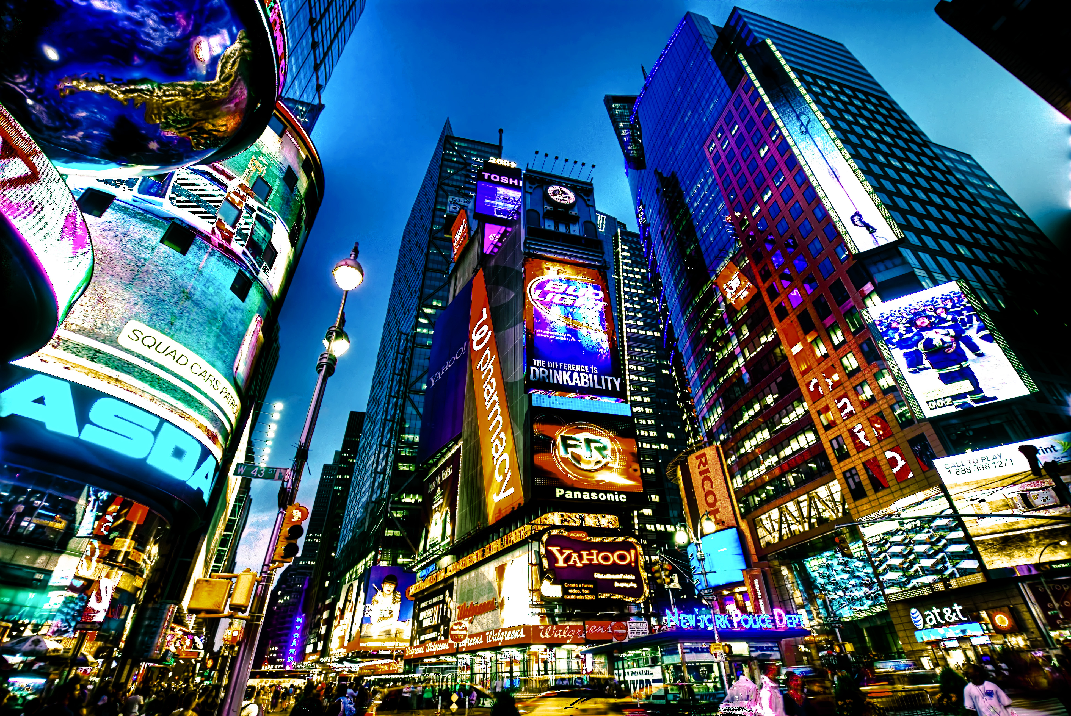


Analysis on Indian restaurants in New York
This Photo by Unknown author is licensed under CC BY-SA.
This Photo by Unknown author is licensed under CC BY.
Capstone Assignment

Slide 2
Introduction
New York City's demographics show that it is a large and ethnically diverse metropolis. It is the largest city in
the United States with a long history of international immigration. New York City was home to nearly 8.5
million people in 2014, accounting for over 40% of the population of New York State and a slightly lower
percentage of the New York metropolitan area, home to approximately 23.6 million. Over the last decade the
city has been growing faster than the region. The New York region continues to be by far the leading
metropolitan gateway for legal immigrants admitted into the United States. Throughout its history, New York
City has been a major point of entry for immigrants; the term "melting pot" was coined to describe densely
populated immigrant neighborhoods on the Lower East Side. As many as 800 languages are spoken in New
York, making it the most linguistically diverse city in the world.
This Photo by Unknown author is licensed under CC BY-NC-ND.

Slide 3
New York City is multicultural. About 36% of the city's population is foreign-born, one of the highest among US cities. The eleven nations constituting thelargest sources of modern immigration to New York City are the Dominican Republic, China, Jamaica, Guyana, Mexico, Ecuador, Brazil, Haiti, Trinidad and Tobago, Colombia, Russia and El Salvador. The New York City metropolitan area is home to the largest Jewish community outside Israel. It is also home to nearly a quarter of the nation's Indian Americans and 15% of all Korean Americans and the largest Asian Indian population in the Western Hemisphere; the largest African American community of any city in the country; and including 6 Chinatowns in the city proper, comprised as of 2008 a population of 659,596 overseas Chinese, the largest outside of Asia. New York City alone, according to the 2010 Census, has now become home to more than one million Asian Americans, greater than the combined totals of San Francisco and Los Angeles. New York contains the highest total Asian population of any U.S. city proper. 6.0% of New York City is of Chinese ethnicity, with about forty percent of them living in the borough of Queens alone. Koreans make up 1.2% of the city's population, and Japanese at 0.3%. Filipinos are the largest southeast Asian ethnic group at 0.8%, followed by Vietnamese who make up only 0.2% of New York City's population. Indians are the largest South Asian group, comprising 2.4% of the city's population, and Bangladeshis and Pakistanis at 0.7% and 0.5%, respectively.
This Photo by Unknown author is licensed under CC BY-NC-ND.

Slide 4
Data
For this project we need the following data :
New York City data that contains list Boroughs, Neighborhoods along with their latitude and longitude...
- Data source : https://cocl.us/new_york_dataset
- Description : This data set contains the required information. And we will use this data set to explore various neighborhoods of new york city.
Indian resturants in each neighborhood of new york city.
- Data source : Fousquare API
- Description : By using this api we will get all the venues in each neighborhood. We can filter these venues to get only indian resturants.
GeoSpace data
- Data source : https://data.cityofnewyork.us/City-Government/Borough-Boundaries/tqmj-j8zm
- Description : By using this geo space data we will get the New york Borough boundaries that will help us visualize choropleth map.
This Photo by Unknown author is licensed under CC BY-SA.

Slide 5
Approach
Collect the new york city data from https://cocl.us/new_york_dataset (https://cocl.us/new_york_dataset)
Using FourSquare API we will find all venues for each neighborhood.
Filter out all venues that are Indian Resturants.
Find rating , tips and like count for each Indian Resturants using FourSquare API.
Using rating for each resturant , we will sort that data.
Visualize the Ranking of neighborhoods using folium library(python)

Slide 6
Questions that can be asked using the above mentioned datasets
What is best location in New York City for Indian Cuisine ?
Which areas have potential Indian Resturant Market ?
Which all areas lack Indian Resturants ?
Which is the best place to stay if I prefer Indian Cuisine ?

Slide 7
Analysis
We will import the required libraries for python
-pandas and numpy for handling data
-request module for using FourSquare API
-geopy to get co-ordinates of City of New York
-folium to visualize the results on a map

Slide 8
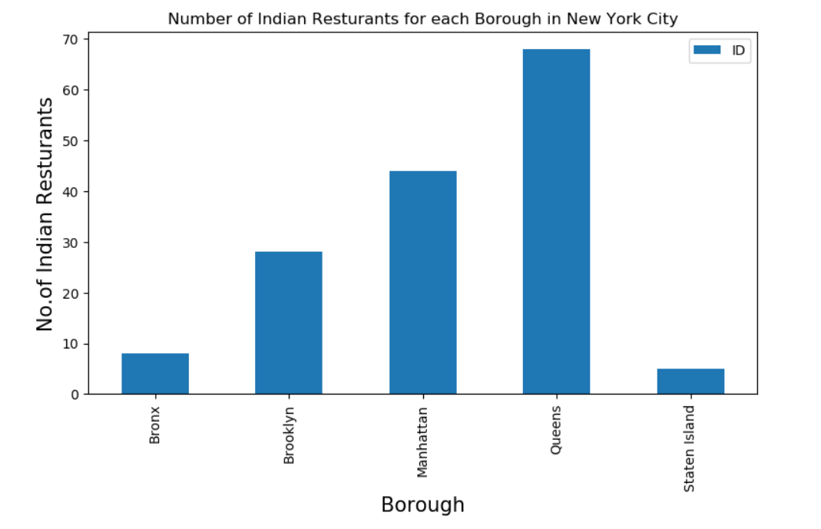

Slide 9
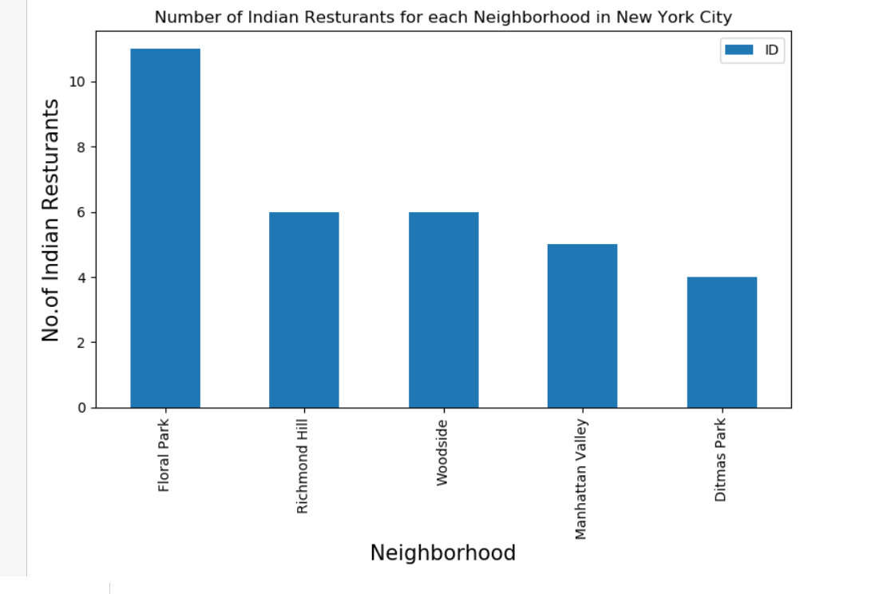
Calculating number of Indian Restaurants in New York
Number of indian restaurants for each borough
NUMBER OF INDIAN RESTAURANTS FOR EACH NeighbourHooD

Slide 10
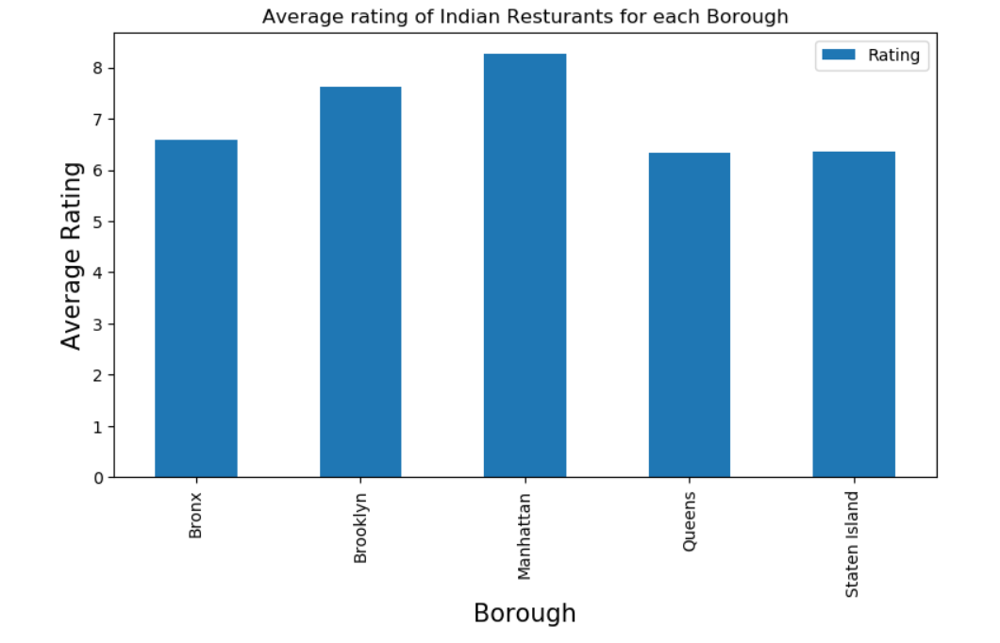
Average rating of Indian Restaurants for each borough

Slide 11
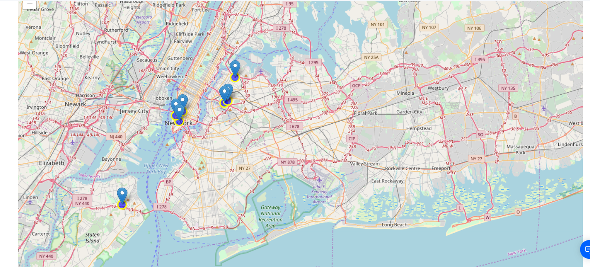
Indian Restaurants in all the neighborhoods with average rating greater or equal 9.0 visualized on map below

Slide 12
Conclusion
Astoria(Queens), Blissville(Queens), Civic Center(Manhattan) are some of the best neighborhoods for indian cuisine
Manhattan have potential Indian Resturant Market
Staten Island ranks last in average rating of Indian Resturants
Manhattan is the best place to stay if you prefer Indian Cuisine

Slide 13
Limitations
The ranking is purely on basis of rating of resturants
The accuracy of data depends purely depends on the data provided by FourSquare

